Slide 1
Integration between services and mediation
Oxford University
Software Engineering Programme
December 2018

Slide 2
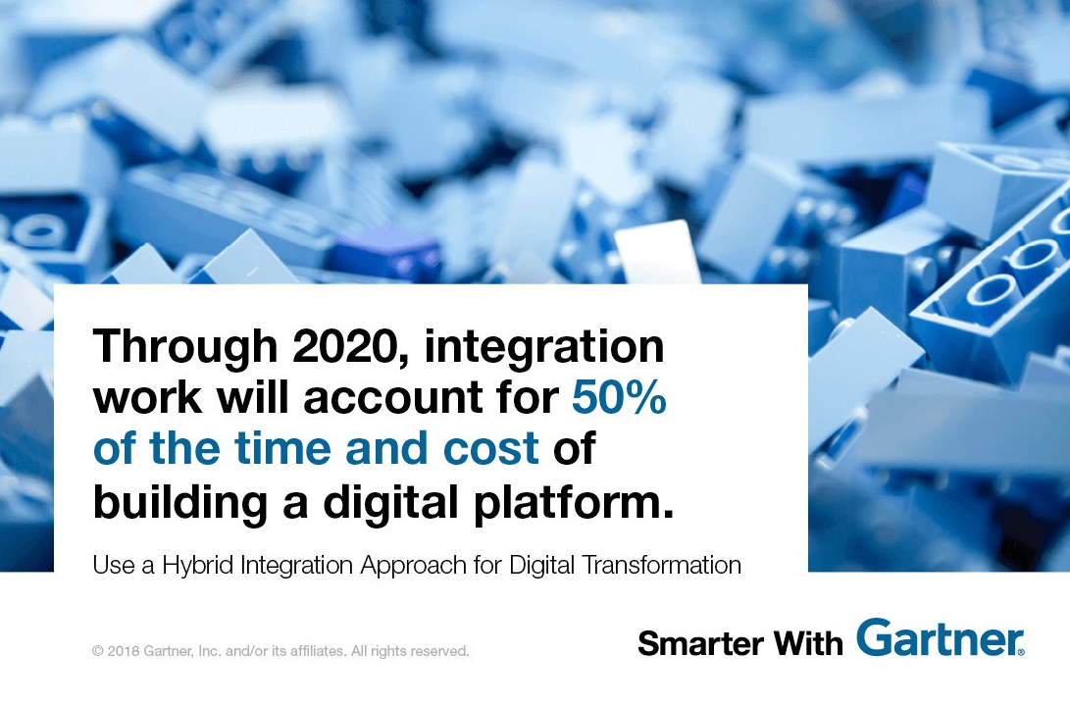

Slide 3

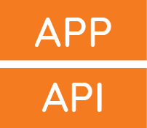





Seven Cases of Integration (from Gartner)
API Management
.
Digital Integration Hub
Application Integratio
Event Streaming
B2B Integration
IOT Integration
Data Integration

Slide 4
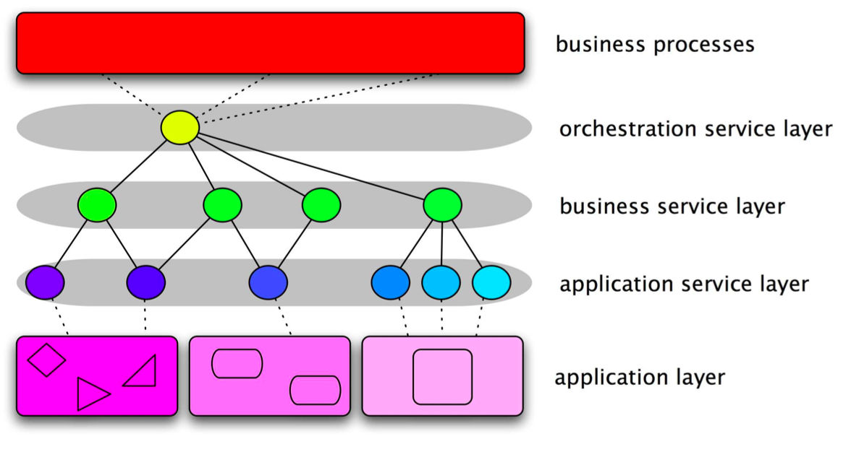
Recap on SOA model

Slide 5
Enterprise Service Bus (ESB)
A software architecture
A logical intermediary through which every message flows
Offers a policy based approach to decide what to do to each message or interaction
The benefits of the gateway model
Without a physical hub and spoke
Many vendors offer ESB products
Often a layer over an existing messaging framework

Slide 6
ESB as an implementation of SOA
Service
Service
Service
Contract
Contract
Contract
Enterprise Service Bus
Routing, Logging, Versioning, Transformation, Mgmt
Process
Management
Portal
Call Center

Slide 7
Different approaches
Point to Point
Traditional EAI
ESB
Event Driven Architecture

Slide 8
Pros and Cons of an ESB
Pros
Faster and cheaper accommodation of existing systems
Increased flexibility: easier to change as requirements change
Standards-based
Scales to enterprise wide deployment
Configuration rather than coding
Cons
May end up with a proprietary solution
no common standards for the overall config and policies yet
Requires more hardware to run
New skills to learn to configure ESB
Hard to get ROI on a small number of projects
Centre of Excellence approach

Slide 9
ESB options
Proprietary
IBM, Oracle, Tibco, SAP
Open Source
Mule, Fuse, WSO2
Apache ServiceMix, Apache Synapse, Apache Camel

Slide 10
ESB models
Almost all ESBs work on the same principle
Message arrives
Sequence of actions (Pipeline)
Message is sent on

Slide 11
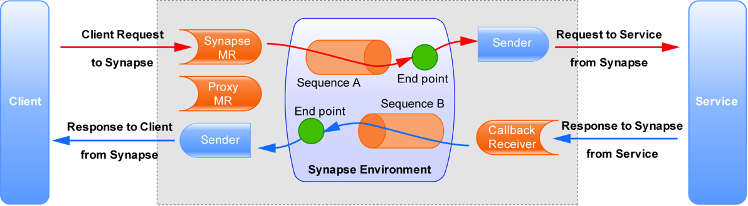
Graphically Apache Synapse terminology used

Slide 12
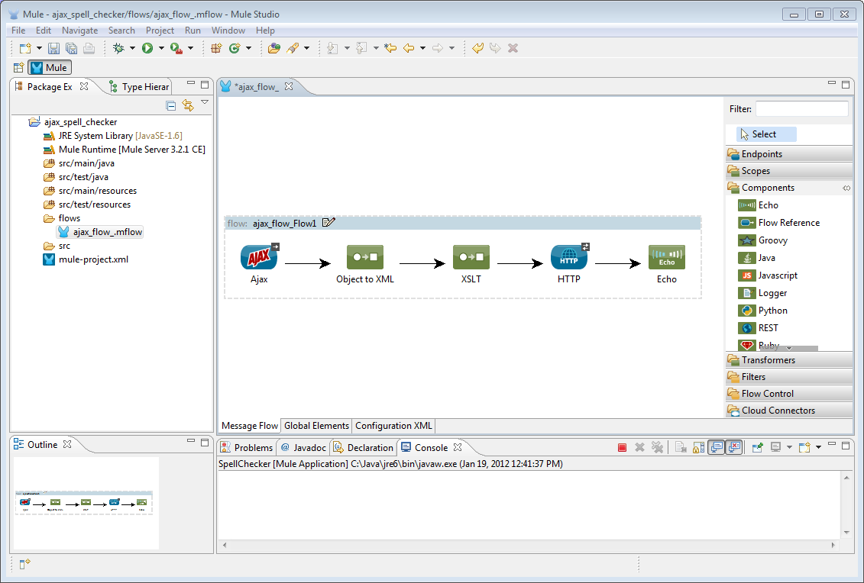
From some tooling

Slide 13
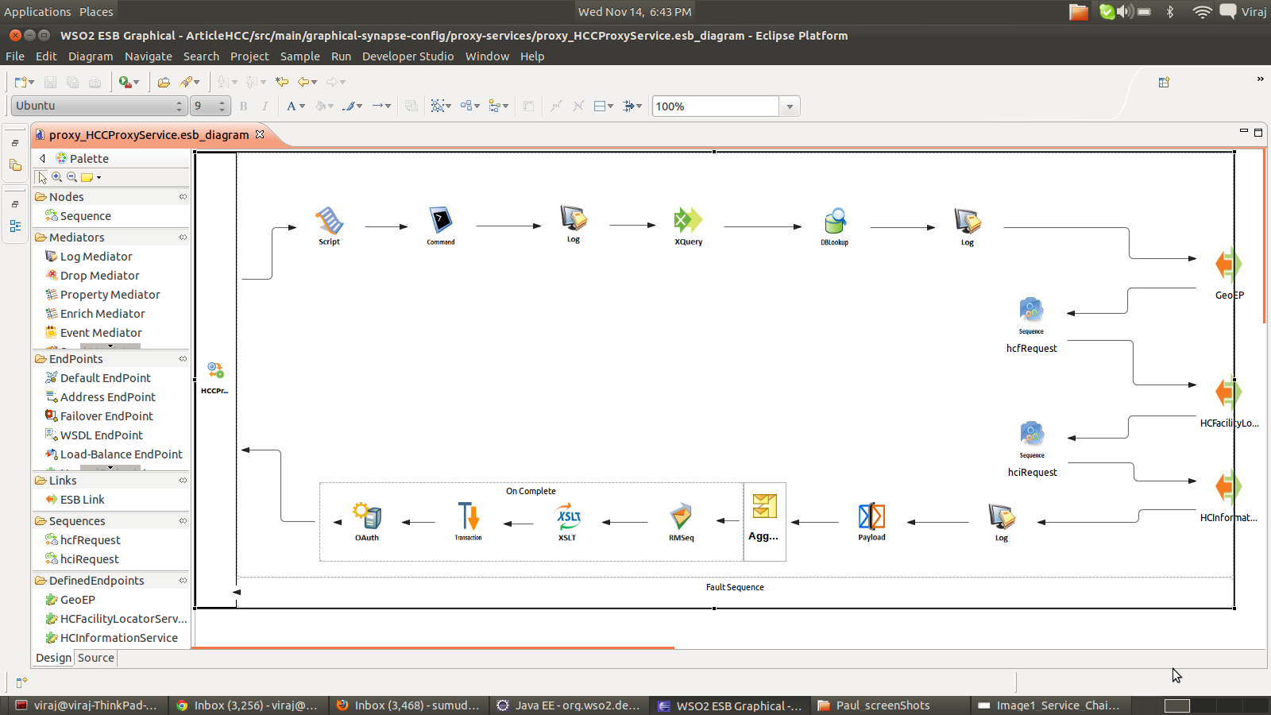
More Tooling

Slide 14
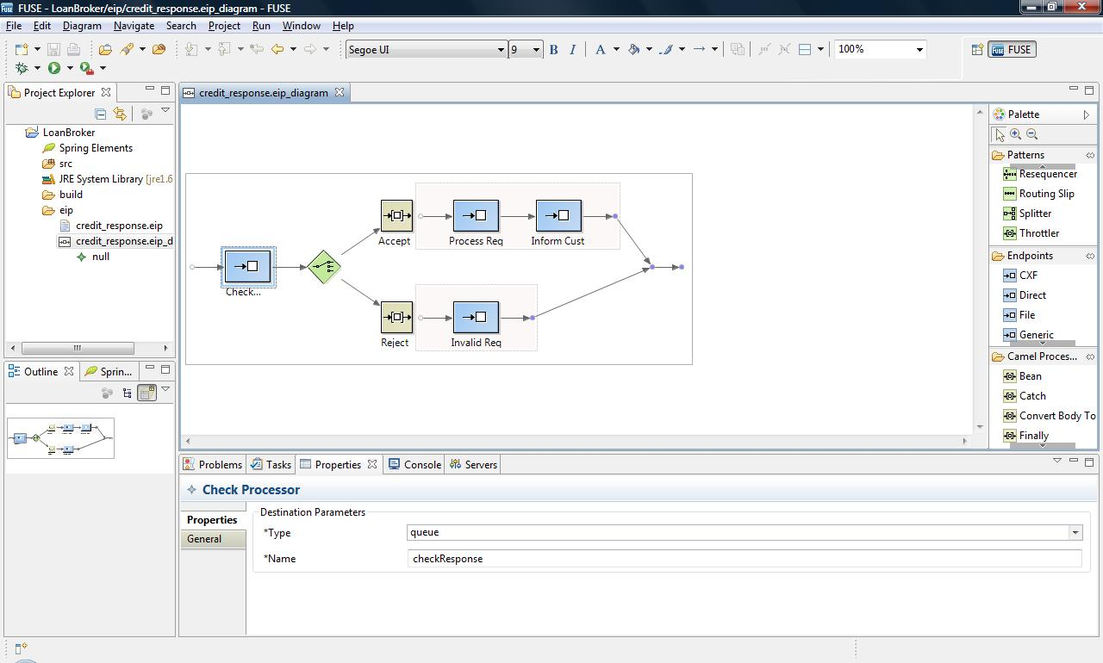

Slide 15
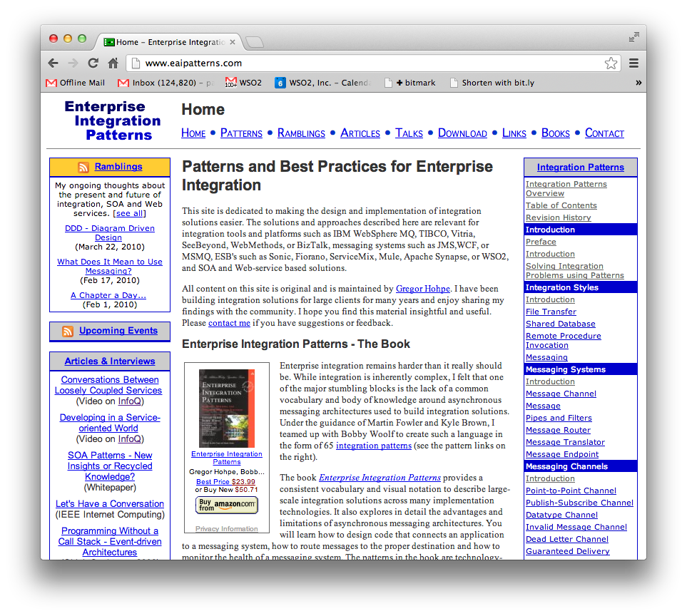
Enterprise Integration Patterns

Slide 16
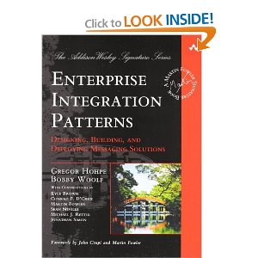
Enterprise Integration Patterns
http://www.eaipatterns.com/
The book
Enterprise Integration Patterns
Gregor Hohpe, Bobby Woolf

Slide 17
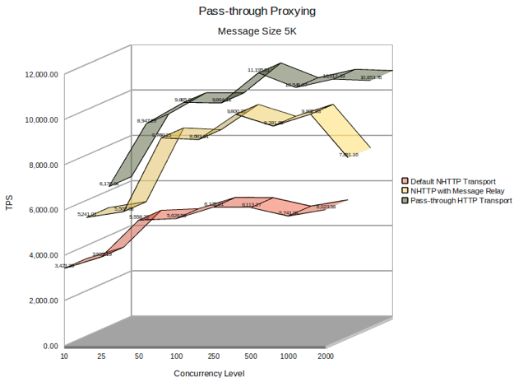
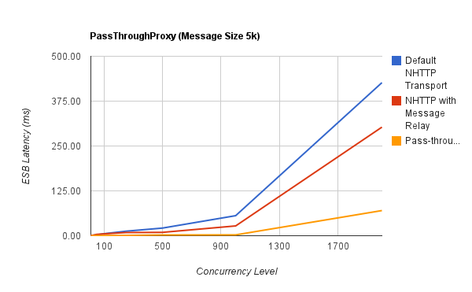
High Performance and Stability
Supports 1000s of concurrent non-blocking HTTP transaction per server
Pure streaming and Optimization using Message relay (on-demand processing of messages)
Very Low latency (0.5 ms for Non-Blocking IO transport)
Long Term Execution Stability with Low Resources Utilization
Response Caching
Latency
TPS

Slide 18
How does mediation / integration fit into Microservices / Containers?
“Smart Endpoints and Dumb Pipes”

Slide 19



ESB-led integration has created “gates” hindering agile development
MONOLITH
Coordinated releases, organizational rigor, centralized change control
PEOPLE
Center of Excellence teams add governance barriers to releases.
Centralized Dev Org
App 1
App 2
. . .
App (n)
App Logic
App Logic
App Logic
INTEGRATION
PROCESS
Middleware and integration systems create trickle-down “gates” decelerating releases.
Scaling
HA
Resilience
Observability
Trickle-down “gates” decelerate releases
Middleware & Integration CoE Teams
MESSAGING
Scaling
HA
Resilience
Observability
Scaling
HA
Resilience
Observability
DATA
Scaling
HA
Resilience
Observability
Scaling
HA
Resilience
Observability
SECURITY
Scaling
HA
Resilience
Observability
TECHNOLOGY
Middleware is a dependency slowing app dev teams.
HA
Resilience
Observability
Ops Team
Compute
Network
Storage
Ops Infrastructure

Slide 20

Brownfield
Greenfield

Slide 21
Core
Systems
Disaggregated systems
Core
Systems
Core
Systems

Slide 22
Core
Systems
Disaggregated systems
Core
Systems
Core
Systems

Slide 23
Core
Systems
Governance
Self-Service
Identity
Dependency Management
Notification
Versioning
Core
Systems
API Management Platform
ESB
Core
Systems

Slide 24
Core
Systems
Core
Systems
API Management Platform
ESB
Core
Systems

Slide 25
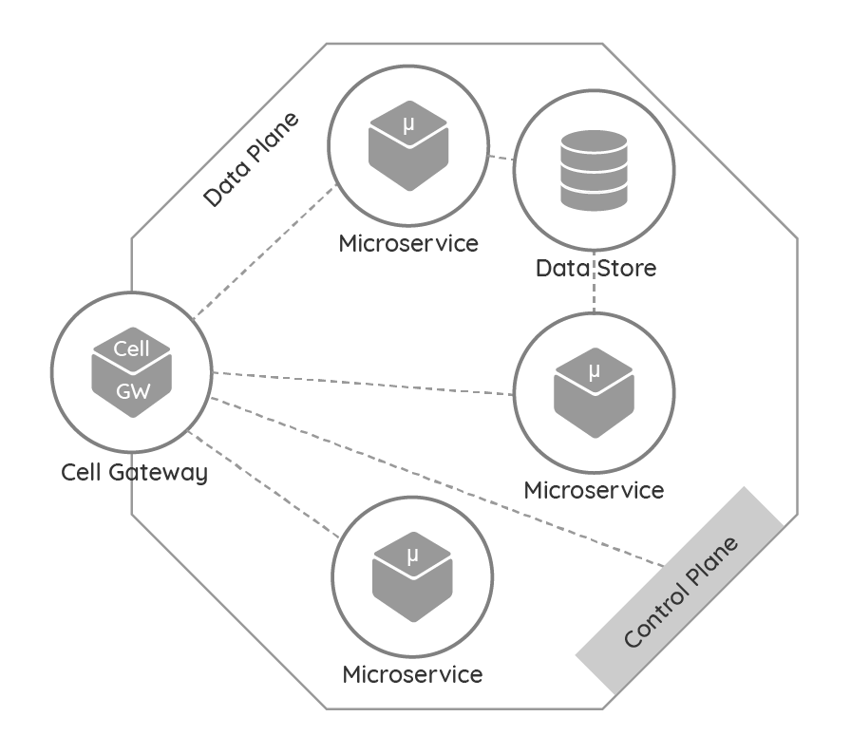
Core
Systems
Cell
Cell
Cell
Cell
Core
Systems
Cell
Cell
API Management Platform / Control Plane
ESB / Data Plane
Cell
Core
Systems

Slide 26
Ballerina Language
A new integration language and framework for Microservices, RESTful SOA
Based on Swagger and Sequence Diagrams
Textual and graphical are 100% interchangeable
https://ballerina.io

Slide 27
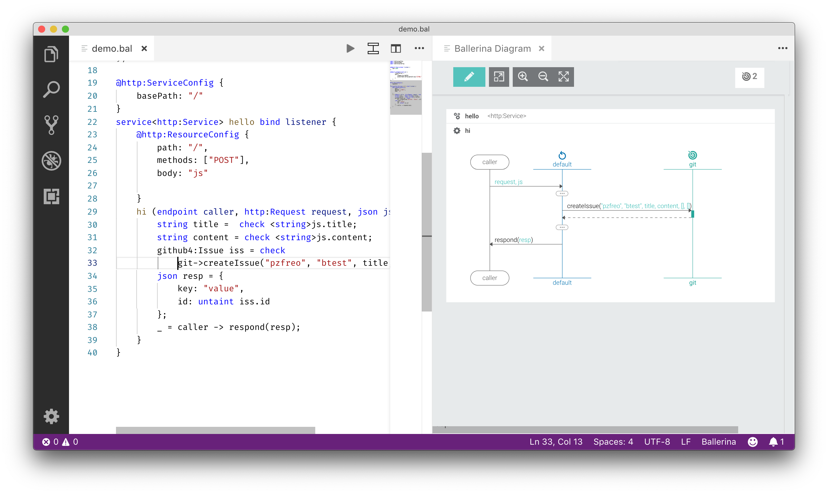
Ballerina diagram and language

Slide 28
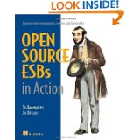
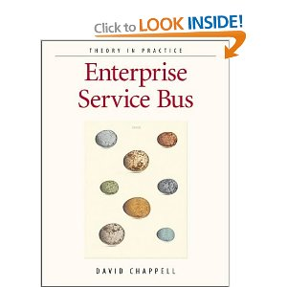
Resources
Wikipedia!
http://en.wikipedia.org/wiki/Enterprise_service_bus
Books
David Chappell: ESB
Open Source ESBs in Action
Open Source
synapse.apache.org
wso2.com/products/enterprise-service-bus
servicemix.apache.org

